Slide 1
Work Progress
By: Abdur Rehman

Slide 2
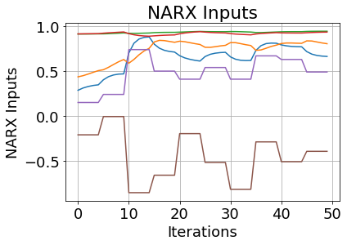
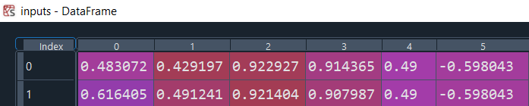
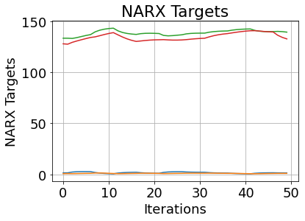

The First NARX Concatenation
nU_delay = int(1)
nY_delay = int(1)
Inputs:
inputs.shape : (3599, 6)
print(inputs):
Targets:
print(targets.shape): (3599, 4)
print(targets):

Slide 3
Keras-Tuner: Hyperparameter Optimization Framework
Tune The Model Architecture:
The first thing we need to do is writing a function, which returns a compiled Keras model. It takes an argument hp for defining the hyperparameters while building the model.
The parameters expected to be tuned:
Number Of Hidden Layers
(hp.Int('hidden_layers', 2, 50))
Number Of Neurons
units=hp.Int('units_nodes_' + str(i), min_value=32, max_value=1024, step=32
Activation Functions
activations=hp.Choice('activation_', ["relu", "tanh", "sigmoid"])
activation=activations
Learning Rate
model.compile(optimizer=tf.keras.optimizers.Adam(hp.Choice('learning_rate', [1e-1, 1e-2, 1e-3, 1e-4, 1e-5]))
Optimizers Used ADAM:
optimizer=tf.keras.optimizers.Adam
Metrices Considered:
metrics=['mean_squared_error', 'mean_absolute_error', 'mean_absolute_percentage_error', 'cosine_proximity’, tf.keras.metrics.RootMeanSquaredError()]
Loss: 'mean_absolute_error'

Slide 4
Results 1:
tuner.results_summary() :
Best Tuning Parameters:
History Test
cosine_proximity | 1.965014934539795
loss | 0.11307789385318756
mean_absolute_error | 0.11307789385318756
mean_absolute_percentage_error | 20.092910766601562
mean_squared_error | 0.030301086604595184
History Train
cosine_proximity | 1.9617092609405518
loss | 0.11908543854951859
mean_absolute_error | 0.11908543854951859
mean_absolute_percentage_error | 21.493276596069336
mean_squared_error | 0.03306350111961365

Slide 6
